Slide 1
Pizza Sales Analytics Report
SQL Server & Tableau
Portfolio Project

Slide 2
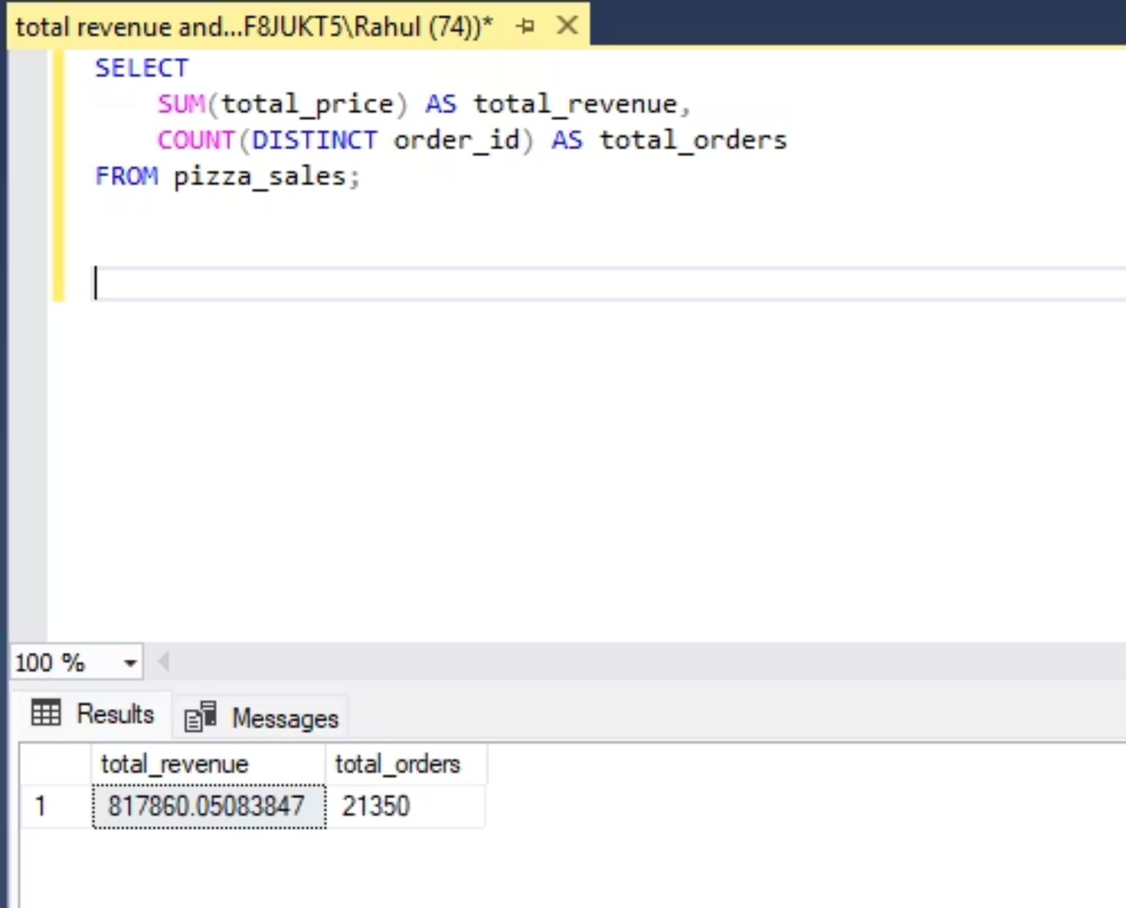
Total Revenue and Total Orders
This query calculates overall business performance by computing total revenue and total unique orders.
Insight:
Provides a high-level snapshot of business scale and demand.

Slide 3
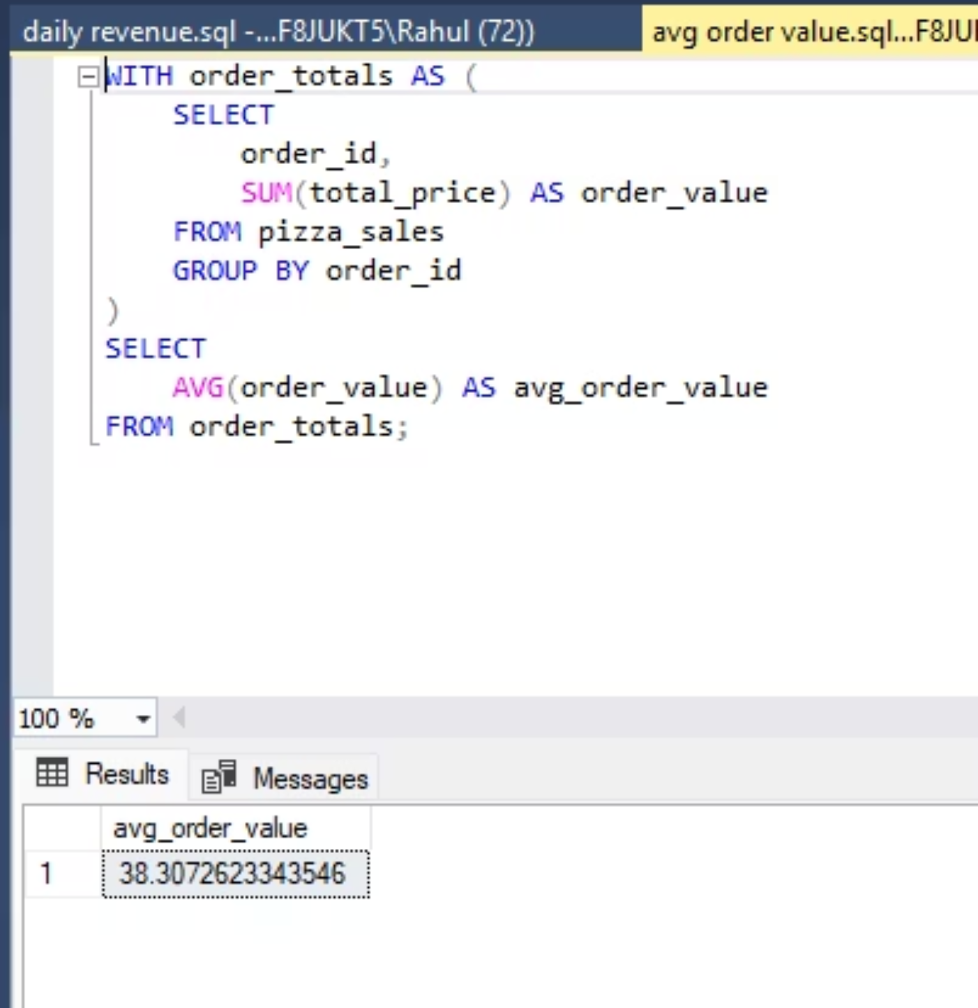
Average Order Value (AOV)
This analysis calculates the average revenue generated per order.
Insight:
Helps understand customer spending behavior.
Useful for pricing and upselling strategies.

Slide 4
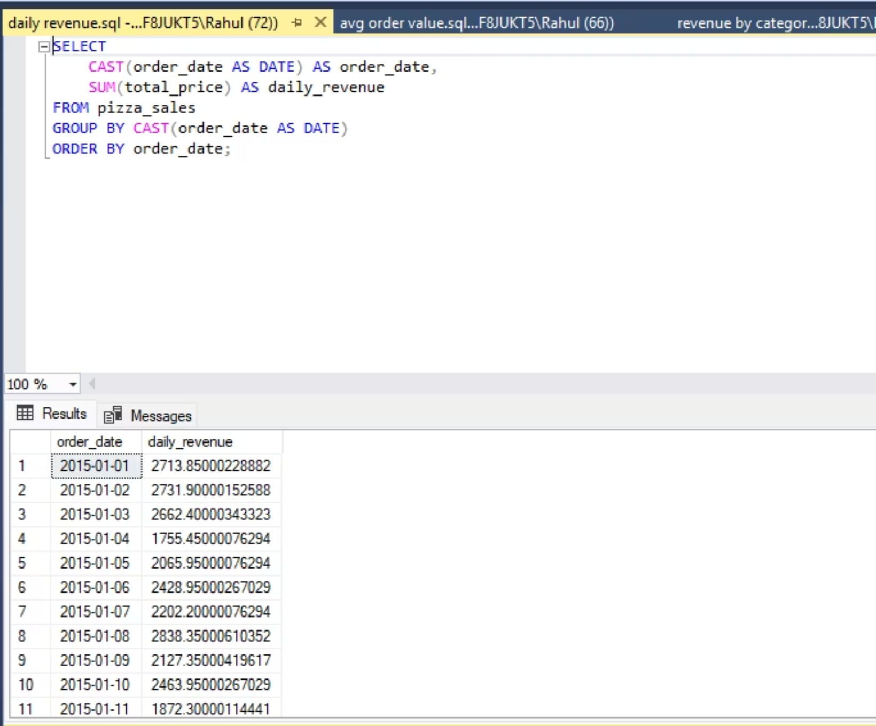
Daily Revenue Analysis
Revenue aggregated at a daily level to identify fluctuations and patterns.
Insight:
Helps identify peak and low-performing days.
Supports operational planning.

Slide 5
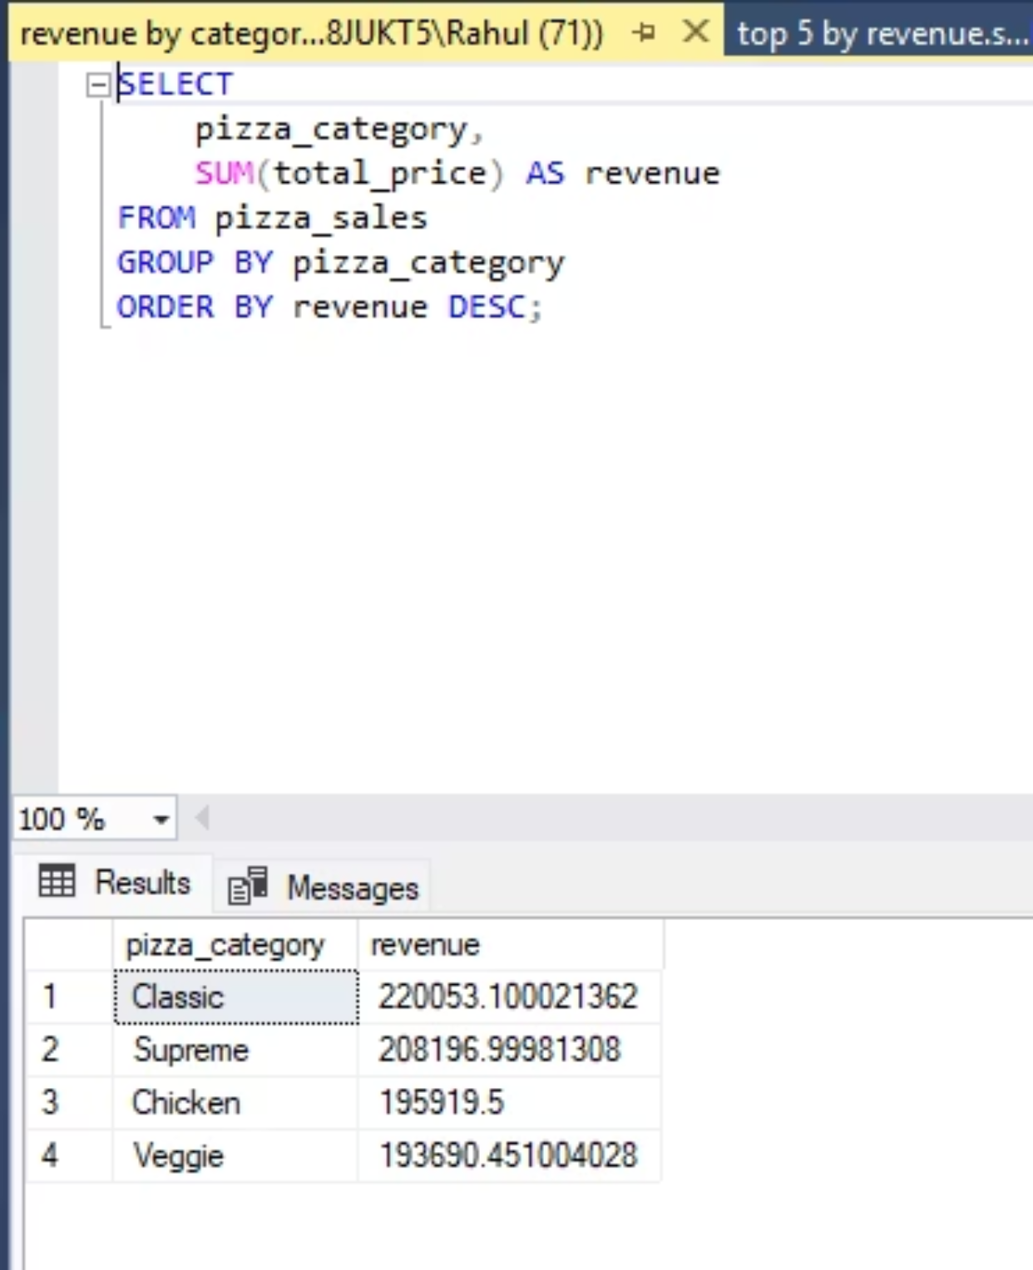
Revenue by Pizza Category
This query groups revenue by pizza category to identify contribution.
Insight:
Classic category contributes the highest revenue.
Category mix informs menu and marketing strategy.

Slide 6
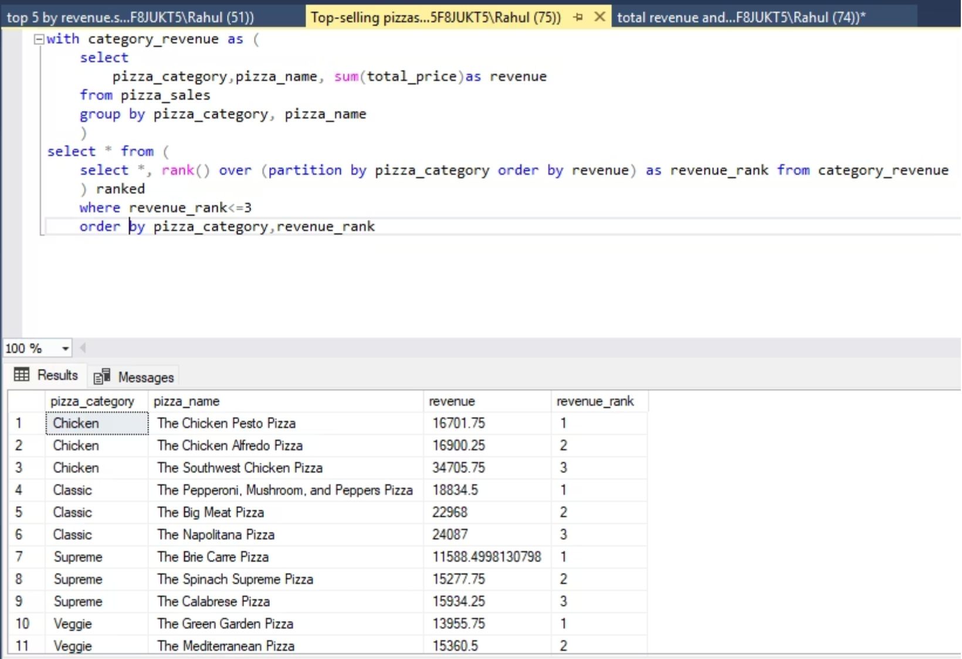
Top 3 Pizzas in Each Category
Window functions were used to rank pizzas within each category by revenue.
Insight:
Identifies star products within each category.
Prevents over-reliance on a single product.

Slide 7
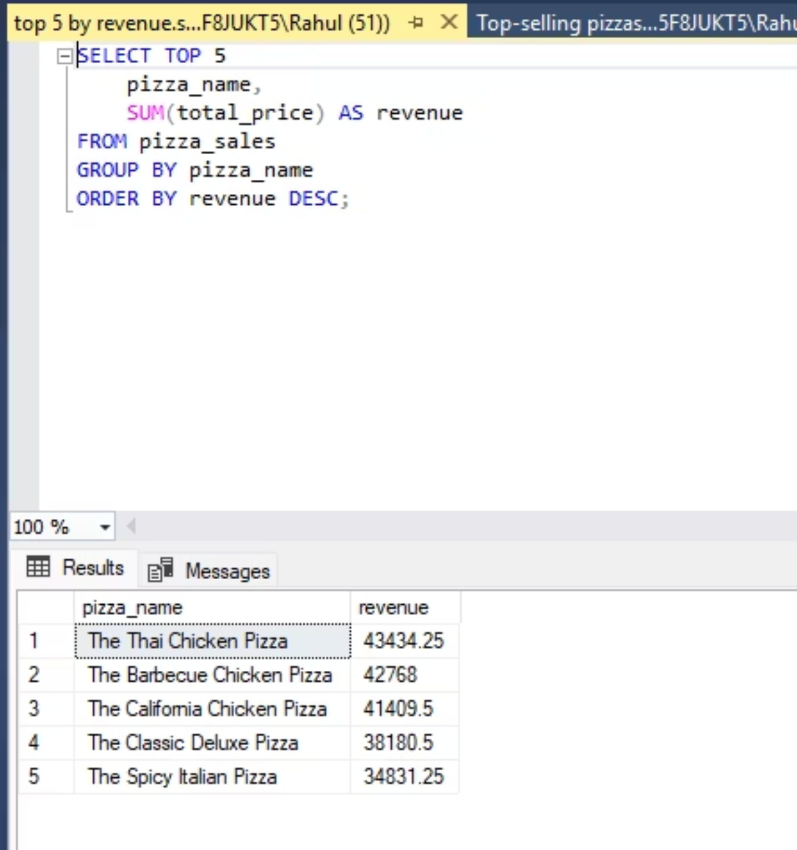
Top 5 Pizzas by Revenue
This query identifies the top revenue-generating pizzas across all categories.
Insight:
A small number of products drive a significant portion of revenue.
Ideal candidates for promotions.

Slide 8
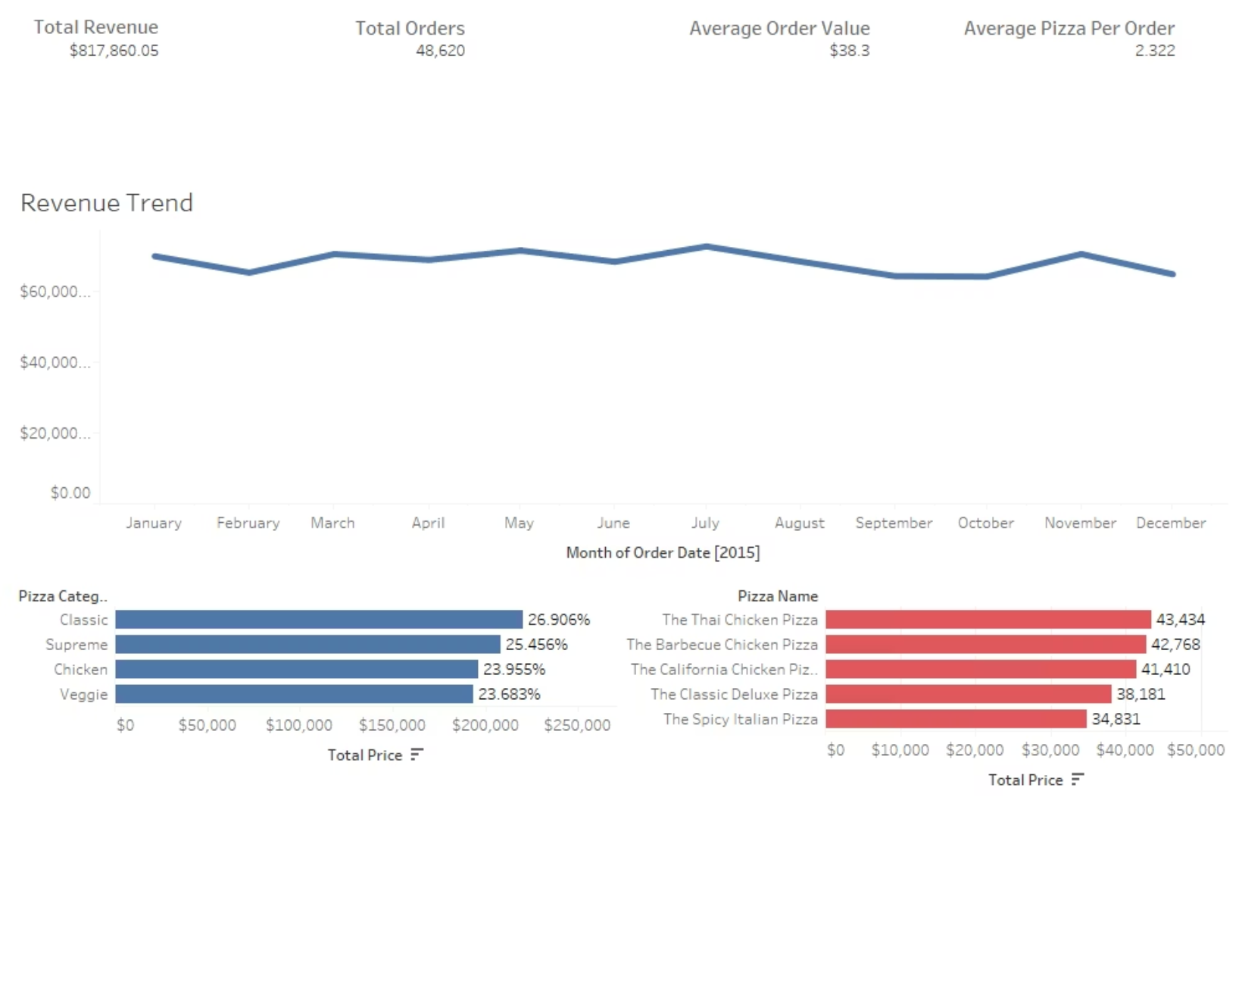
Interactive Tableau Dashboard
The SQL outputs were visualized using Tableau to create an executive-level dashboard.
Dashboard Features:
KPI summary
Revenue trend
Category and product insights

